Slide 1
Social
Name
Title
Company

Slide 2
Agenda
Overview
Newsfeed, Sites & SkyDrive Pro
Microfeed
Following, @Me, My Activities, My Likes
Communities

Slide 3
Overview

Slide 4
Social Features
Newsfeed, Sites, and SkyDrive (aka My Site)
My Likes
My Tasks
SkyDrive Pro
Microblogging
Following
Mentions
Likes
Communities
Notes:
Let’s first look at an overview of the social features. The My Site, Microblogging, and Communities make up three significant areas of the new social features in SharePoint 2013
MySite helps aggregate everything relevant to a user and encompasses things like the users newsfeed, sites, tasks, and skydrive pro
Microblogging provides a rich social platform for connecting the dots between people and topics through posts, likes, mentioned, and following
And Communities is a rich new template for organizing groups around community with membership, discussions, and reputations

Slide 5
Architecture
Personal Site
App Fabric
Cache
Microfeed
Social
SkyDrive
Profile DB
Sites
Docs
People
Tags
System
User
Notes:
This slide outlines the high-level architecture of sources that play into the delivery of social features in SharePoint 2013:
Microfeed List – Contains all the activity around a user. Activities can be user generated (post) or system generated (profile change)
Social List – contains the list of all things that a person is following such as documents, people, sites, tags…think of it as a users subscriptions
Profile Database – contains profile information, followed people, and tags
SkyDrive Pro – personal document library with features to share content with other and see document that have been shared with you
App Fabric Cache – also new to 2013 and is used to store the latest activities so they may be displayed quickly on the What’s New page. You can imagine social activity can be very chatty and the App Fabric (also called Velocity Cache) helps reduce the impact querying all the my sites in the organization, which are likely broken across multiple content databases
Hopefully this diagram illustrates that the My Site is the key to delivering many of the new social features in SharePoint 2013. Every user will need a My Site to participate in the social features in SharePoint 2013
But not to worry…My Sites have both Social quota and Content quota that can help IT administrators keep a handle on growth. Some social activity counts as content, some content counts against social.

Slide 6
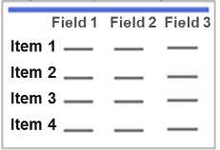
App Fabric Cache
Windows AppFabric Cache (non-persisted storage)
Document Feed
Tag Feed
My Site User Feed
Company Feed
Site Feed
Content databases (persistent storage)
My Site Content Database
Site content database
Private feed list
Public feed list
Site feed list
User Actions or System Activities
Document Post
Tag post
People post
Site post
Notes:
This slide shows how the App Fabric Cache participates in the deliver of social activity in SharePoint 2013
Remember, the App Fabric Cache – is used to store the latest activities so it can be displayed quickly on the What’s New page.
Document and Tag Activities are written only to the cache and bypass traditional persistent storage
Where as People and Site activities are written to persistent storage, then the cache
One key point is that the App Fabric Cache is available across all WFEs in the farm, so it plays nice with load balancing

Slide 7
Newsfeed, Sites & SkyDrive Pro
Notes:
Now that we have an overview, let’s dig deeper into the MySite that delivers things like a users Newfeed, sites, and SkyDrive Pro

Slide 8
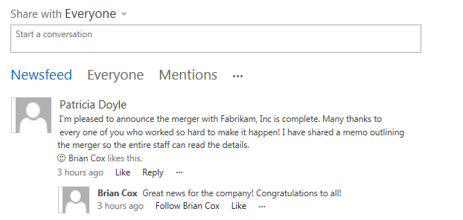
Newsfeed
Private view
Updates on things you follow
New Posts from Others
Profile changes
Changes to followed documents
Things tagged with followed tags
Mentions
My Activities
My Likes
Notes:
The newsfeed is a private view that allows a user to see posts that are relevant to them such as
New posts from people they are following of containing tags they are following
Profile changes
Changes to followed documents
Mentions
My activities and my likes

Slide 9
My Tasks
Single view of tasks across SharePoint, Project, and Exchange
Enterprise Search gathers SharePoint tasks
Connects to Project and Exchange for other tasks
New “Work Management” Service Application performs aggregation
Hidden List in “My Site” caches data
New items can also be added
Updates are reflected back to original task
Notes:
My Tasks provide a unified view of users tasks across the organization…and I’m not just talking about SharePoint Tasks in one farm…it can works across SharePoint farms, Project, and Exchange
If you have ever done anything with SharePoint tasks, maybe in a process-driven site with workflows, you know that these tasks have traditionally been isolated in their own container and this really helps break down the walls of those containers
Tasks can even be synched back into outlook so you can work in the client you are most comfortable with
The Task aggregation is managed by a new service application called the Work Management Service
The My site plays into this by providing a hidden list where the tasks get cached

Slide 10

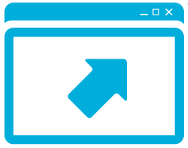

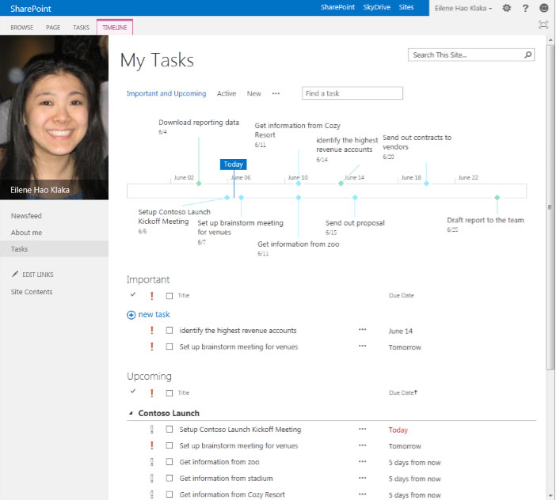




Work Management Service Application
Call as Proj server user mapped to SP User
Project Server DB
Personal Site
3
Refresh request
Write personal tasks
1
2
6
Read personal tasks
My Tasks Page
Change tasks into list
Work Management Service
Get Tasks via OM
7
4
Call as SP User
5
List on Personal Site
SP Content DB
SP Web App Change Log
Notes:
Let’s take a look at a diagram that shows how the work management service orchestrates tasks across a number repositories
User goes the their MySite and views My Tasks
This generates a refresh request against the work management service
The work management service can then go off to project,
the SharePoint web app change log for any new tasks that have been assign or changed
The SharePoint content database
Exchange
Once that information has been collected, the WMS caches the tasks in a hidden list on the users my site

Slide 11
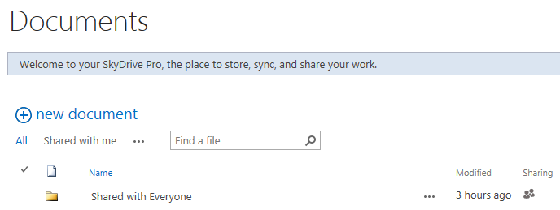
SkyDrive Pro - See and Share Documents
Notes:
SkyDrive Pro is a place for a user to store/share personal document, and see documents shared with them from other users
SkyDrive Pro provides very similar functionality to the consumer version of SkyDrive, but something you can run onprem or in O365 with all the content governance that might be desired on enterprise content like discovery, retention, and compliance

Slide 12
SkyDrive Pro
Single personal library
All: provides an overall view of documents in the library
Personal: shows documents in the library that have not be shared with anyone
Recent: provides a view of the library grouped by dates
Shared by me: provides the ability to show who can access to what in the library
Shared with me: provides the ability to show all documents that have been shared with you across people’s libraries
Notes:
SkyDrive Pro has a number of interesting default views including
All, which provides an overall view of the documents
Personal, which are documents that have not be shared with others
Recent, providing a document listing by date
Shared by me allows a user to quickly see documents that have been shared with others
Finally, Shared with me view provides a view of documents that have been shared with me from others peoples SkyDrive Pro
Shared with me is unique in that looks like any other listview but, in reality, it uses Search underneath to aggregate content
there’s a lag time (default 15 minutes) before the document appears in the view.
The query is smart in gathering the information:
it looks for all documents that contain “IsMyDocuments” managed property.
This essentially returns all documents in all SkyDrive Pro.
Search does security trimming, so it only returns documents which the querying user has permission to view
So there might be a million documents in all the SkyDrive Pros across the enterprise, but if only 20 have been shared with me
It is important to note that all views have a share icon so a user won’t be confused on what content is or is now shared…either a lock or a people icon

Slide 13
SkyDrive Pro Client
Provides access to documents stored in SharePoint 2013 in the Windows Explorer
Makes your documents accessible online, offline or in-between and your changes are automatically synced
Overlays on files and folders, so you can easily tell if your content is in sync
Can be used with any document library in SharePoint 2013
Notes:
Skydrive pro provides access to documents stored in SP 2013 from Windows Explorer
This is different from a traditional WebDav Windows Explorer view…
The Skydrive Pro client makes your document accessible online or office and keeps the documents automatically synched with the online copy
SjyDrive Pro is powered by a grown-up version of Groove, which later become SP Workspace
When I’m in the windows explorer, overlays on files and folders indicate if content is in sync
Although this is called SkyDrive Pro client, it can be used with any document library in SharePoint 2013

Slide 14
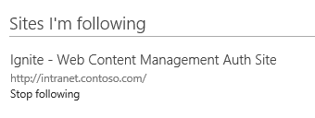
Sites- Sites you are following
Notes:
Finally, there are sites, which is another following area of SharePoint 2013
Sites provides an aggregated view of sites the user chooses to follow
Users can go to any site in SharePoint 2013 and click a follow button to add the site to this aggregated list

Slide 15
Personal Site
demo

Slide 16
Microfeed

Slide 17
Overview
Microfeed List
Stores all activity related to the user
Activities can be user or system generated
Admins control what system-generated activities appear
System-generated activities are security trimmed
App Fabric Cache
Activities are generally added to the cache as well
CSOM and REST APIs
Notes:
Let’s talk about the microfeed…the microfeed
Stores all activity related to the user
Activities in the microfeed list can be user generated such such as a user posting a message or system generated such as a Title change, Anniversary, or Birthday
Admins control what system-generated activities appear
System-generated activities are security trimmed…for example if Birthday was a profile property only shared with a users manager, that system-generated activity would security trimmed appropriately
The App Fabric Cache plays a key role in the delivery of the Microfeed. You can imagine social activity can be very chatty, so the App Fabric Cache allows social activity to be cached across all WFEs in a farm so activity can be quickly accessed
For extending the Microfeed, CSOM and REST APIs help expose the microfeed so that developers can create solutions that interact and extend these social capabilities

Slide 18
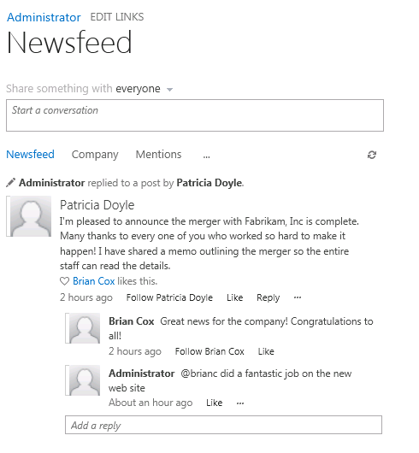
Microfeed: Following
People
Sites
Documents
Tags
Notes:
The microfeed is driven around following…you can follow people, sites, documents, and tags
Behind the scenes, things are followed based on a GUID, so Name changes, document holds, and declaring records does not impact the follow (although these actions could stop all new changes)
Restoring from the Recycle Bin could stop following on a document

Slide 19
Microfeed: @me
“Mentioning” a Person
Updates user’s microfeed
Updates the mentioned person’s microfeed
Notes:
The microfeed supports @ mentioning of people, which allows users to post a messages with strong references back to the person mentioned
@ mentioning updates the user’s microfeed and the mentioned persons microfeed

Slide 20
Microfeed: My Likes
“Liking” a Post
Updates user’s microfeed
Updates the post author’s microfeed
Updates App Fabric cache
Notes:
The microfeed also supports Like…you can like a post or a reply to a post
Liking a post updates the user’s microfeed, the post authors microfeed, and the app fabric cache

Slide 21
Microfeed: Server-Side API
Object Model
Microsoft.Office.Server.UserProfiles.dll
Key Classes
SPMicrofeedManager
PeopleManager
Notes:
SPMicrofeedManager allows you to work with feeds
PeopleManager works with profiles and following

Slide 22
Microfeed: CSOM API
Managed Client Object Model
Microsoft.SharePoint.Client.UserProfiles.dll
JavaScript Client Object Model
SP.UserProfiles.js
Key Objects
MicrofeedManager
PeopleManager
FollowedContent
Notes:
The Microfeed is also exposed through a CSOM API with both managed code and javascript
The Managed Client Object Model can be found at Microsoft.SharePoint.Client.UserProfiles.dll
The JavaScript Client Object Model can be found at SPUserProfiles.js
Both of these are built on top of the existing SharePoint CSOM. So you first get a ClientContext instance and then use that to work with social-specific objects
As an example, if I were developing using the Managed CSOM and the .NET Framework, I would get a ClientContext instance and then use that with the object model in the Microfeed namespace and UserProfiles namespace from the Microsoft.SharePoint.Client.UserProfiles assembly.
If I were doing the same thing in JavaScript, I would get an SP.ClientContext instance from the JS CSOM and then use the object model in the SP.UserProfiles.js file to access the microfeed
Some of the key objects in the Social API include:
the MicrofeedManager object to get feeds, to post to threads, to like and unlike entities, and to perform other feed-related tasks.
the PeopleManager object to retrieve user properties, to start or stop following people, to retrieve list of followed people, and to perform other "following people" tasks.
the FollowedContent to object to start or stop following content, to get followed content, and to perform other "following content" tasks.
the MicrofeedPostDefinitionManager object to create custom post types and to retrieve, update, and delete post types

Slide 23
Microfeed
demo
Notes:
Let’s look at a solution that interacts with microfeed

Slide 24
Communities

Slide 25
Communities
Communities are built by using a new site template type
Builds on the concepts of discussions, likes, ratings, badges and reputations
Uses Wiki Pages infrastructure
A community is based on set of lists that exist in the community itself
Notes:
A community is a group of people the come together around a common interest or cause
SharePoint 2013 supports Communities through a new community site template
So just like you can provision team sites, blank sites, publishing sites, and other templates, you will now have a community site option
The template brings together social concepts such as membership, discussions, likes, ratings, badges, and reputation and also leverages the wiki page infrastructure for people to easily contribute to the site and form the community
Behind the scenes a number of lists help deliver the community capabilities

Slide 26
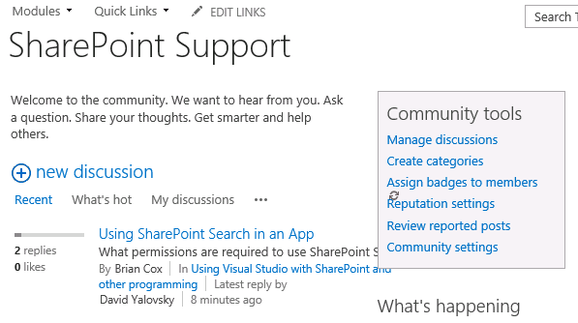
Communities - Sample Home Page
Notes:
This slide just shows an example of a community landing page…there is a lot going on here…you can see a
Welcome message at the top of the page that could easily be delivered through wiki pages
A list of discussion that can be sorted by recent activity, hot discussions, my discussions, and more
Community tools, which are targeted towards a community administrator
What’s happening that might display some statistics on the community activity
You might even display Top Contributors based on their contributions/activity in the community
And much more…

Slide 27
Communities - Feature Set
Discussions
Categories, Posts, Replies, Likes
Ratings, Reputation, Report Abuse, Gifts
Administration
Discussions
Categories
Members
Gifts
Abuse
Notes:
The discussion is a central part of the new community template…they allow users to participate in discussions on specific topics through posts, replies, likes, reporting abuse, and even marking a reply as a best answer
By participating in the community, users automatically begin to build up a reputation based on a scoring system configured by an administrator. This allows some gameifacation that can automatically assign badges and rank top contributors in the community
Administrators can manage discussions, create discussion categories, manage members and assign them gifted badges, configure reputation settings, review reported posts that might be considered inappropriate, and much more

Slide 28
Communities
demo

Slide 29
Summary
Overview
Personal Site
My Tasks, My Libraries
Microfeed
Following, @Me, My Activities, My Likes
Communities

Slide 30

© 2012 Microsoft Corporation. All rights reserved. Microsoft, Windows, Windows Vista and other product names are or may be registered trademarks and/or trademarks in the U.S. and/or other countries.
The information herein is for informational purposes only and represents the current view of Microsoft Corporation as of the date of this presentation. Because Microsoft must respond to changing market conditions, it should not be interpreted to be a commitment on the part of Microsoft, and Microsoft cannot guarantee the accuracy of any information provided after the date of this presentation. MICROSOFT MAKES NO WARRANTIES, EXPRESS, IMPLIED OR STATUTORY, AS TO THE INFORMATION IN THIS PRESENTATION.

